Slide 1
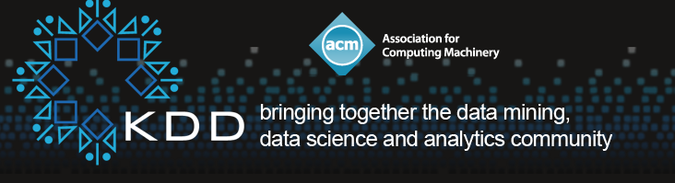
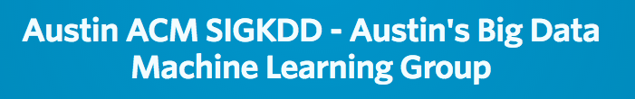


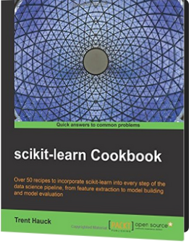

Advanced Machine Learning
with Python
Sponsored by

Slide 2
WiFi connection
Connect to “other network”.
Type in the network name. It is lightning
all lower case letters.
NO e in the middle
Mac users select WPA2 Personal.
Then type the password zeuswgafc

Slide 3
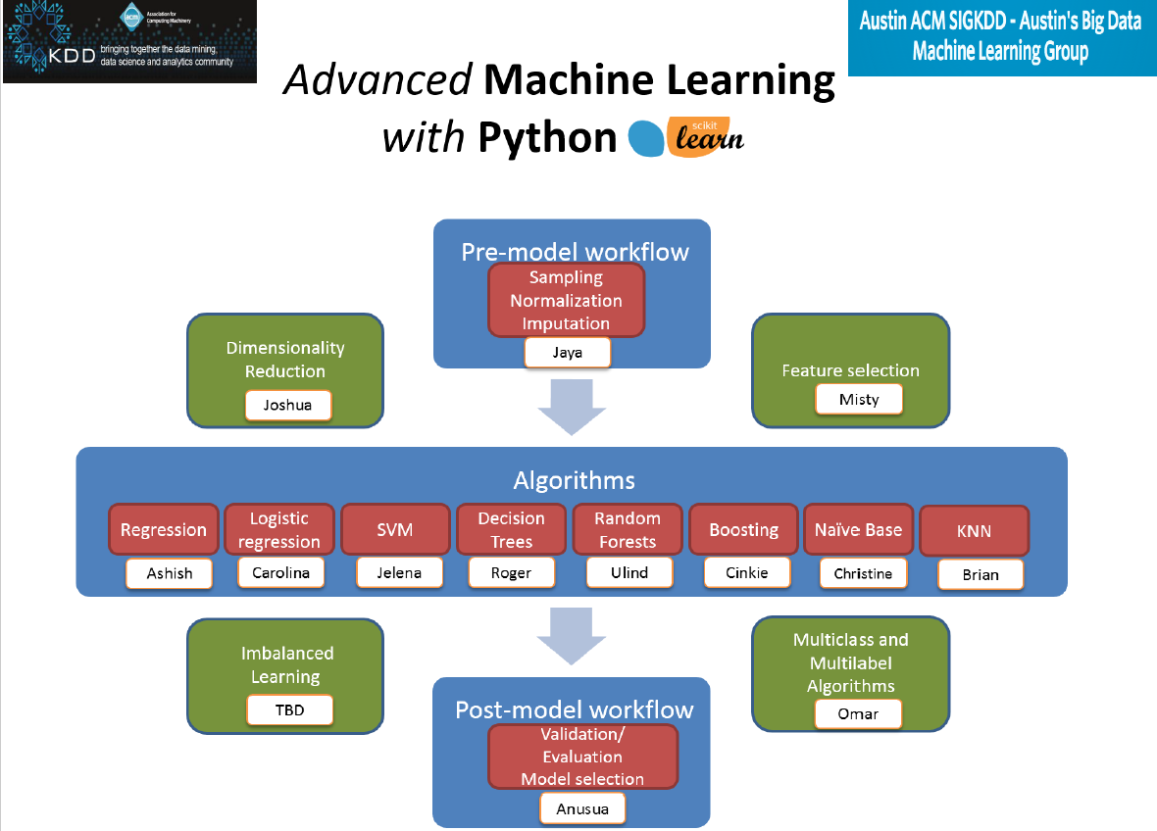

Slide 4



Advanced Machine Learning with Python
Session 7: Imbalanced Learning
Tim Gasser
github.com/timgasser/acm_imbalanced_learning
@tim_gasser
medium.com/@timgasser
Notes:
“The github has all the slides, code, and datasets from today’s presentation”
”If you have a laptop and want to follow along with the examples, you can clone the github repo. Any updates send a pull request !”
”The presentation is broken into short sections, if you have any questions please let me know”

Slide 5
Overview
Introduction to imbalanced learning
Evaluation metrics
Imbalanced learning approaches
Sampling
Algorithms
Kaggle dataset evaluation
Conclusions
Notes:
”The book has a few details on imbalanced learning (weighted algorithms), there are some more techniques here”
“I want to gauge people’s experience. Can I have a show of hands if: You know about …
Classification
ROC and AUC
Tomek links

Slide 6
Introduction to imbalanced learning
Formal definition of imbalanced learning [1]: ‘…the learning process for data representation and information extraction with severe data distribution skews to develop effective decision boundaries to support the decision-making process.’
Informally, imbalanced learning is the training of machine learning algorithms on datasets where far fewer examples exist of one class than others.
The imbalance ratio is the ratio between classes of each type. It can vary between 100:1 to 10,000:1.
This presentation will focus on imbalanced learning with classification algorithms.
Notes:
“As well as between class skew you can have within class skew” – housing example

Slide 7
Introduction to imbalanced learning (contd)
Classification use-cases with imbalanced data
Fraud detection, anomaly detection, cancer detection, predicting credit defaults
In imbalanced learning, prediction of the minority class examples is more important than the majority class.
Unfortunately the algorithm has far of these fewer minority class examples to learn from.
Standard algorithms focus on reducing the cost of misclassifying all examples, not just minority ones.
In future slides, I’m assuming we’re predicting the minority class (so positive means minority example).
Notes:
“Predicting rare events is much more useful than events that happen 50% of the time”
“Any questions?”

Slide 8
Evaluation Metrics

Slide 9
Evaluation of imbalanced learning
When training classifiers, accuracy is often used to quantify how good the model is.
Accuracy is defined as TP + TN / N
Take a dataset with a 95:5 imbalance ratio
The most naïve model predicts the most common case for every example.
This has 95% accuracy on the dataset above !
But this mis-classifies all the minority class examples.
We need a different metric to optimize!

Slide 10
Alternative imbalanced metrics
Precision (TP / TP + FP) and Recall (TP / TP + FN) give more useful information about the minority-class performance of the model. But using two figures as a metric is inconvenient.
Alternative is to use the F1 score (harmonic mean of precision and recall) = 2TP / (2TP + FP + FN)
A more visual representation of the model’s performance is the Receiver Operating Characteristic (ROC).
The Area Under the Curve (AUC) is a single metric to quantify model performance.
 | Predicted Positive | Predicted Negative
Actual Positive | True Positive (TP) | False Negative (FN)
Actual Negative | False Positive (FP) | True Negative (TN)

Slide 11
Area under Roc Curve
The classification algorithm outputs a probability of the example being a positive case (between 0 and 1).
This probability is converted into a positive/negative by applying a decision threshold.
The ROC Curve shows how the FPR and TPR vary as this threshold is varied from 0 (top right) to 1 (bottom left).
The area under the curve (AUC) is independent of the threshold, and shows how well the model is performing.
Image source[3]

Slide 12
ROC Curves and decision thresholds
The decision threshold can be adjusted based on the relative costs of FPs and TPs.
For example in cancer detection:
False Positive: The patient has a further un-necessary scan to confirm the incorrect diagnosis.
True Positive: Cancer is correctly diagnosed.
There is a good case for decreasing the threshold of the model.
This will increase the TPR, with a small increase in FPR.
Image source[3]
Notes:
“Any questions?”

Slide 13
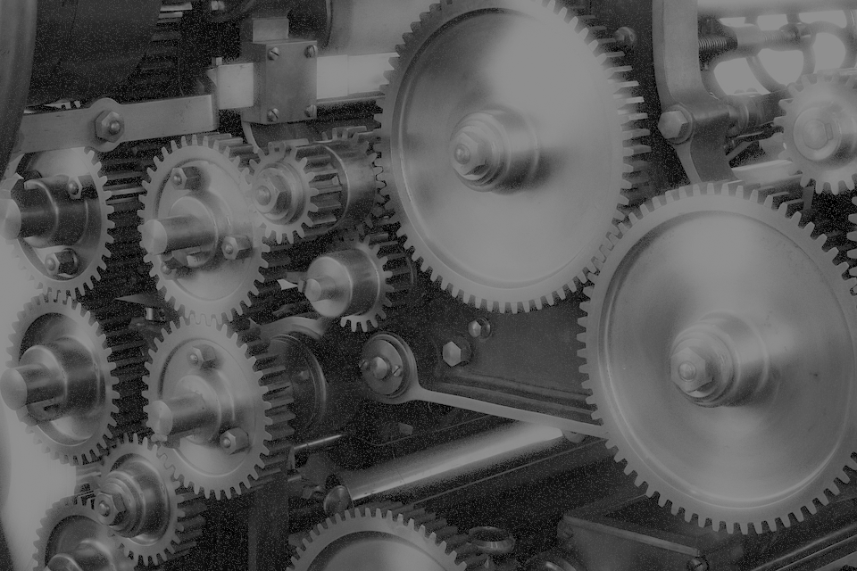
Imbalanced learning techniques

Slide 14
Imbalanced learning techniques
To get good predictive performance on imbalanced datasets, you can do the following
Data pre-processing. This modifies the dataset to reduce the imbalance before training the model.
Algorithm-specific. Depending on the algorithm used, weighting can be used to increase the penalty for mis-classifying a minority example.
Ensemble. By training multiple models and combining the results, performance can be increased over a single model. This is not just true for imbalanced datasets.
Notes:
”Pre-processing wasn’t covered in the scikit learn book, so I spend some time discussing this”
“I won’t have time to cover ensemble methods here, but there are references at the end if you’re interested.”

Slide 15
Data pre-processing
Notes:
“I’m going to discuss the pre-processing methods here, and have a notebook with some examples”
“The aim of pre-processing is to create a new dataset with better balance”

Slide 16
Data pre-processing
There are two options to generate a 50:50 balanced dataset from an imbalanced one
Oversampling: Generate new minority class examples.
Undersampling: Remove majority class examples.
These can be done at random, but there are issues
Random oversampling gives issues with overfitting, as there will be many identical duplicated minority examples.
Random undersampling means you throw away good majority data.
To improve on the performance of random under and oversampling, kNN-based methods selectively add or remove data.

Slide 17
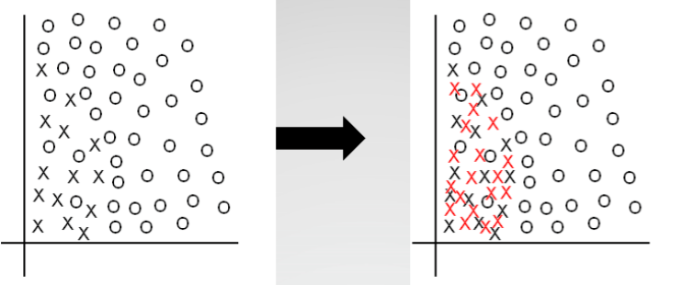
Oversampling methods
Synthetic Minority Oversampling Technique (SMOTE)
For each minority example
Randomly chose one of the k nearest neighbours (majority or minority)
Create a new sample a random distance between the minority example and the nearest neighbour.
This allows the minority example class space to be expanded.
Image source[2]

Slide 18
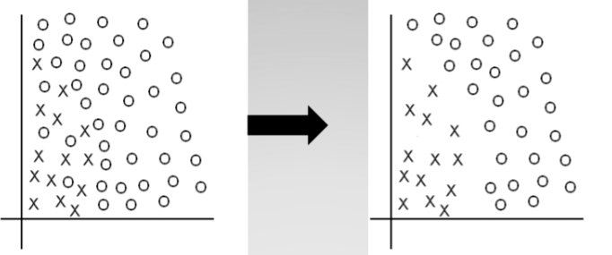
Undersampling methods
Tomek Links
Find pairs of points that are different classes, they form a Tomek link if there is no closer example to either point.
Remove majority example in the pair.
Effectively widens the decision boundary between majority and minority.
Image source[2]

Slide 19
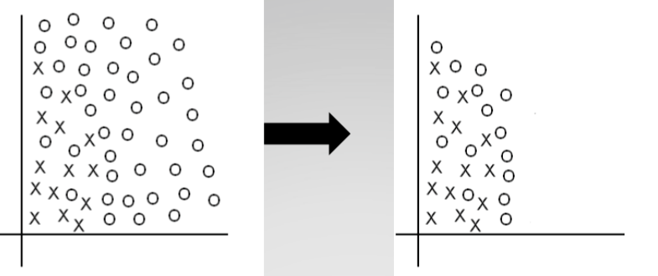
Undersampling methods
Condensed Nearest Neighbor (CNN)
Removes all points, and adds them back in as required to correctly predict the examples with a kNN classification where k=1.
CNN removes majority class examples that are distant from the decision border.
Image source[2]

Slide 20
Combining undersampling methods
One-Sided Selection (Tomek links followed by Condensed Nearest Neighbor Rule)
Removing majority-class examples from Tomek links increases the separation between majority and minority class feature spaces.
Condensed Nearest Neighbor Rule removes majority examples far from the class borderline.
Image source[2]

Slide 21
Data pre-processing tools and APIs
Python’s scikit-learn library doesn’t support any of the dataset processing methods. These don’t fit well with the sklearn API:
https://github.com/scikit-learn/scikit-learn/issues/4617
I found a repo on Github which supports all the techniques described and more besides:
https://github.com/fmfn/UnbalancedDataset
R has a package called ‘unbalanced’ which also supports all the pre-pre-processing modes:
https://cran.r-project.org/web/packages/unbalanced/unbalanced.pdf
To understand the algorithms, I coded several using a small example in the the notebook. Demo !
acm_imbalance_sampling.ipynb
Notes:
”If you’re following along, open up the acm imbalance sampling notebook”

Slide 22
Cost-sensitive Algorithms
Notes:
Cost sensitive algorithms can factor in class imbalance in their loss function and gradient.

Slide 23
Solutions – Cost-sensitive methods
With a dataset of 95:5 imbalance, mis-classifying the minority examples can contribute a maximum of 5% of the loss.
This will skew the model towards correctly classifying the majority samples !
To solve this, we can weight the classifications using the inverse of class frequency.
So scale each mis-classification of the minority class by the imbalance
Scaling the minority class cost by 95/5 = 19 gives a cost function ratio of 95:95.

Slide 24
Solutions – Cost-sensitive methods
The following classifiers in scikit-learn can adjust weights inversely to class frequencies
sklearn.linear_model.LogisticRegression
sklearn.tree.DecisionTreeClassifier
sklearn.svm.LinearSVC
The API is standard across these classifiers (copied below)
class_weight : dict or ‘balanced’, optional
The “balanced” mode uses the values of y to automatically adjust weights inversely proportional to class frequencies in the input data as n_samples / (n_classes * np.bincount(y))
To test the performance of the weighted classifiers, I’m going to use a real-world dataset.

Slide 25
Real-world use-case
Notes:
Explain background of kaggle
“How many people have a kaggle account”?
”How many people have competed in a competition?”

Slide 26
Evaluation dataset
For this presentation, we’ll use the Kaggle ‘Give Me Some Credit’ dataset from Dec 2011
https://www.kaggle.com/c/GiveMeSomeCredit .
The aim of the competition was to ‘Improve on the state of the art in credit scoring by predicting the probability that somebody will experience financial distress in the next two years.’
Evaluation metric is ’AUC’ - Area Under (ROC) Curve.

Slide 27
Evaluation dataset (features)
Variable Name | Description | Type
SeriousDlqin2yrs | Person experienced 90 days past due delinquency or worse | Y/N
RevolvingUtilizationOfUnsecuredLines | Total balance on credit cards and personal lines of credit except real estate and no installment debt like car loans divided by the sum of credit limits | percentage
age | Age of borrower in years | integer
NumberOfTime30-59DaysPastDueNotWorse | Number of times borrower has been 30-59 days past due but no worse in the last 2 years. | integer
DebtRatio | Monthly debt payments, alimony,living costs divided by monthy gross income | percentage
MonthlyIncome | Monthly income | real
NumberOfOpenCreditLinesAndLoans | Number of Open loans (installment like car loan or mortgage) and Lines of credit (e.g. credit cards) | integer
NumberOfTimes90DaysLate | Number of times borrower has been 90 days or more past due. | integer
NumberRealEstateLoansOrLines | Number of mortgage and real estate loans including home equity lines of credit | integer
NumberOfTime60-89DaysPastDueNotWorse | Number of times borrower has been 60-89 days past due but no worse in the last 2 years. | integer
NumberOfDependents | Number of dependents in family excluding themselves (spouse, children etc.) | integer

Slide 28
Evaluation overview
The first section of the notebook explores the dataset, and compares classifiers trained with accuracy instead of AUC, and with class weights.
The second section uses pre-processed datasets generated in R to evaluate the performance boost.
“Which is better, R or Python?”
Use best libraries from both ☺
Notes:
Go over to the notebook at this point

Slide 29
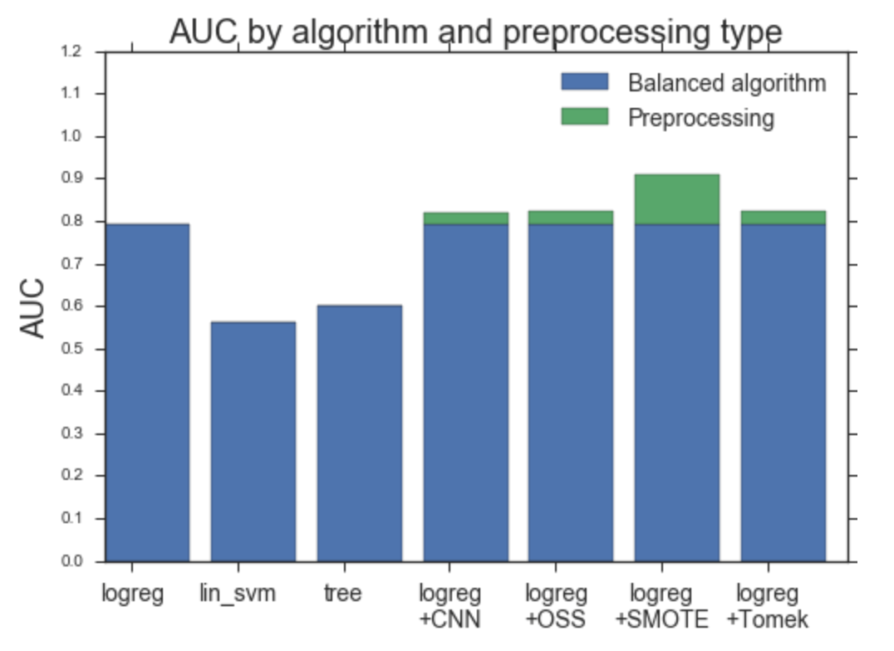
Evaluation results

Slide 30
Evaluation results
Logistic regression (using weighted classes) in combination with SMOTE is the best performing model, with AUC = 0.909667.
Evaluation on the Kaggle ‘Give me some credit’ dataset shows:
Training with the correct metric is crucial.
Balancing class weights is important for a 95:5 imbalanced dataset.
Pre-processing the data with SMOTE gives a significant boost in AUC.

Slide 31
Conclusions
scikit-learn does not support any data pre-processing, but does support weighted classes in classifier algorithms.
The ’unbalanced’ R package does support data pre-processing.
But using R in the pipeline complicates the flow slightly.
Ensemble algorithms are another solution for class imbalance, unfortunately there wasn’t time to present them here.
See BalanceCascade and EasyEnsemble (in [4]), for more information.

Slide 32
Thank you !
Any questions?

Slide 33
References
[1] - Imbalanced Learning: Foundations, Algorithms, and Applications (1st ed), Haibo He, Yunqian Ma (link).
[2] – Mining when classes are imbalanced, rare events matter more, and errors have cost attached, SIAM Data Mining Conference (SDM 2009), Nitesh V. Chawla (link).
[3] - ECOL/BIOL 563 Statistical Methods in Ecology, Fall 2010 (link)
[4] - “Exploratory undersampling for class-imbalance learning,” IEEE Transactions on Systems, Man, and Cybernetics - Part B: Cybernetics, vol. 39, no. 2, pp. 539–550, 2009. X.-Y. Liu, J. Wu, and Z.-H. Zhou.
[5] - K. Chidananda and G. Krishna, “The condensed nearest neighbor rule using the concept of mutual nearest neighbor”, IEEE Trans. Information Theory, Vol IT- 25 pp. 488-490, 1979.

